Slide 1


Demand Reduction Strategies
Extend Orchard Replacement (EOR) Pilot Study
Precision Irrigation (PI) Pilot Study
Vina GSA Board of Directors – March 11, 2026
Joel Kimmelshue, PhD, Land IQ

Slide 2
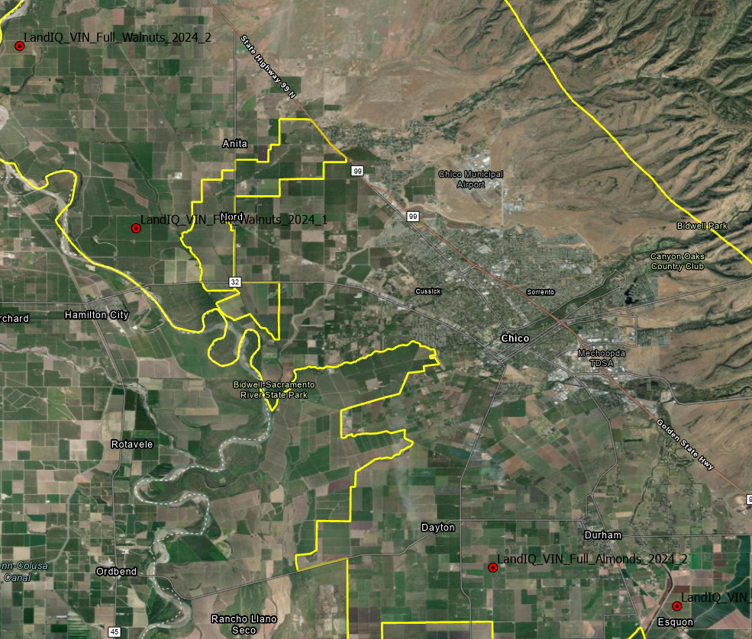
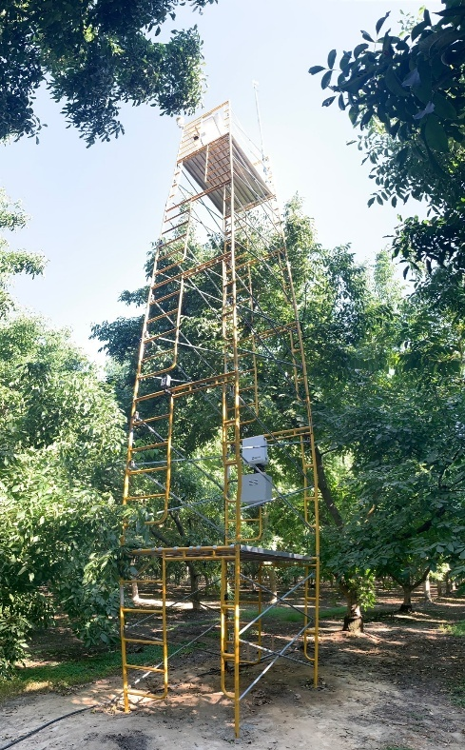
Spatial Data for Pilot Studies - ET
Notes:
In the autumn of 2024, Land IQ installed four ET field stations in the Vina Subbasin in the following locations (Figure X):
20-year old walnut orchard in the northwest part of the Subbasin,
9-year old walnut orchard in the northwest part of the Subbasin,
8-year old almond orchard on the east side of the Subbasin and SE of Durham,
15-year old almond orchard in the southwest part of the Subbasin,
Short season crop (such as beans or winter cereals) ET for comparison to removed orchard.

Slide 3
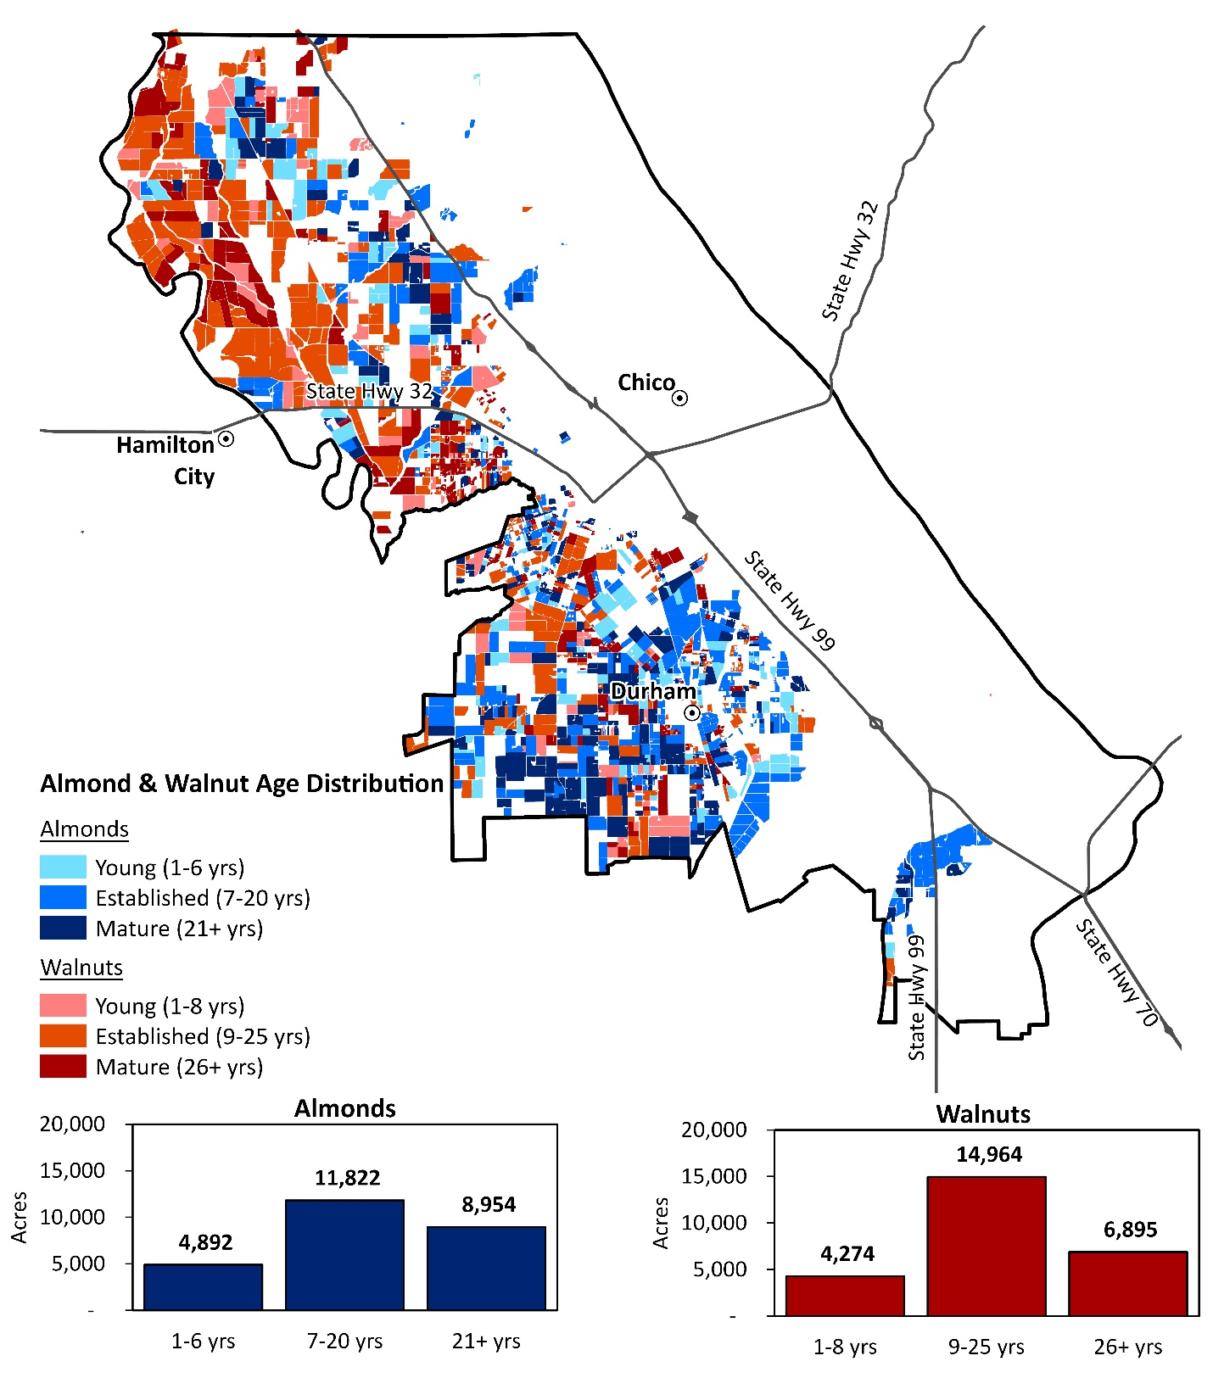
Spatial Data
Crop type and age
25,668 acres of Almonds
26,133 acres of Walnuts
Notes:
Spatial data that helped us select pilot orchards, find orchards of similar type in the subbasin-wide analysis, and interpret results

Slide 4
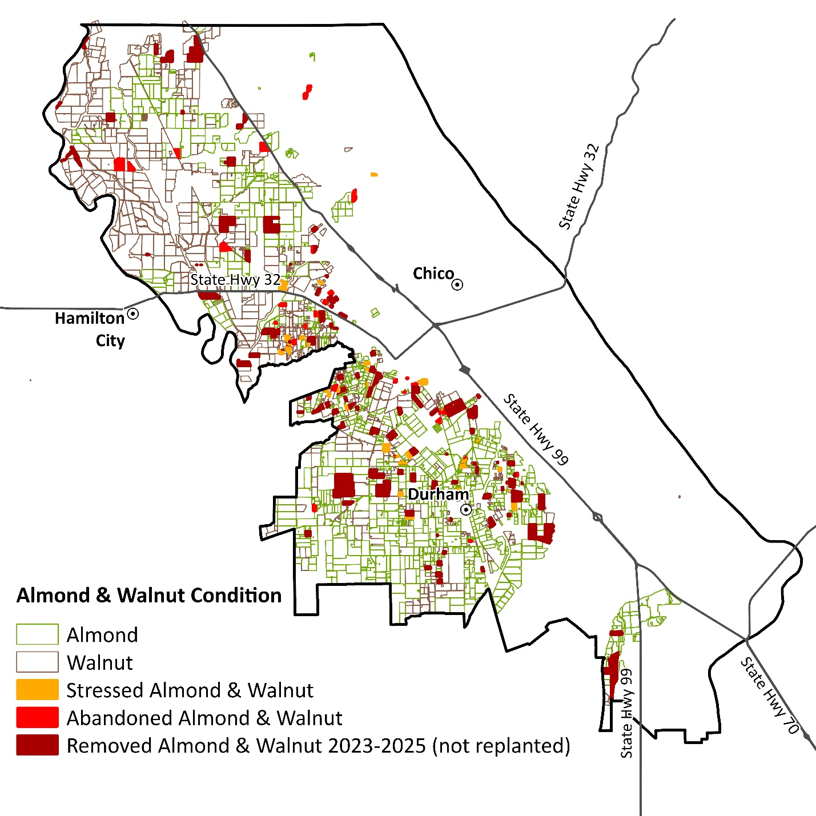
Spatial Data
Crop type and condition
Notes:
Spatial data that helped us select pilot orchards, find orchards of similar type in the subbasin-wide analysis, and interpret results

Slide 5
EOR – Pilot Study Questions
What types of practices/systems (e.g. interim or cover crops) are used on idle orchard ground and how much water do they consume?
What are the costs, co-benefits and water savings of an extended orchard replacement period over the life of an orchard?
How can this knowledge be used to guide the GSA in implementing programs that realize the benefits of extended orchard replacement?

Slide 6
EOR – Analysis
Pilot Orchards provided guiding information
ET
Idle period options – fallow, cover crop, summer cash crop, etc.
Analysis focused on the whole basin.
All orchards in Vina Subbasin were used for analysis
Condition – bearing, abandoned
ET
Notes:
Reported results in the form of case studies
Each case study has definition of idle ground practice, potential co-benefits, water use and economic analysis

Slide 7
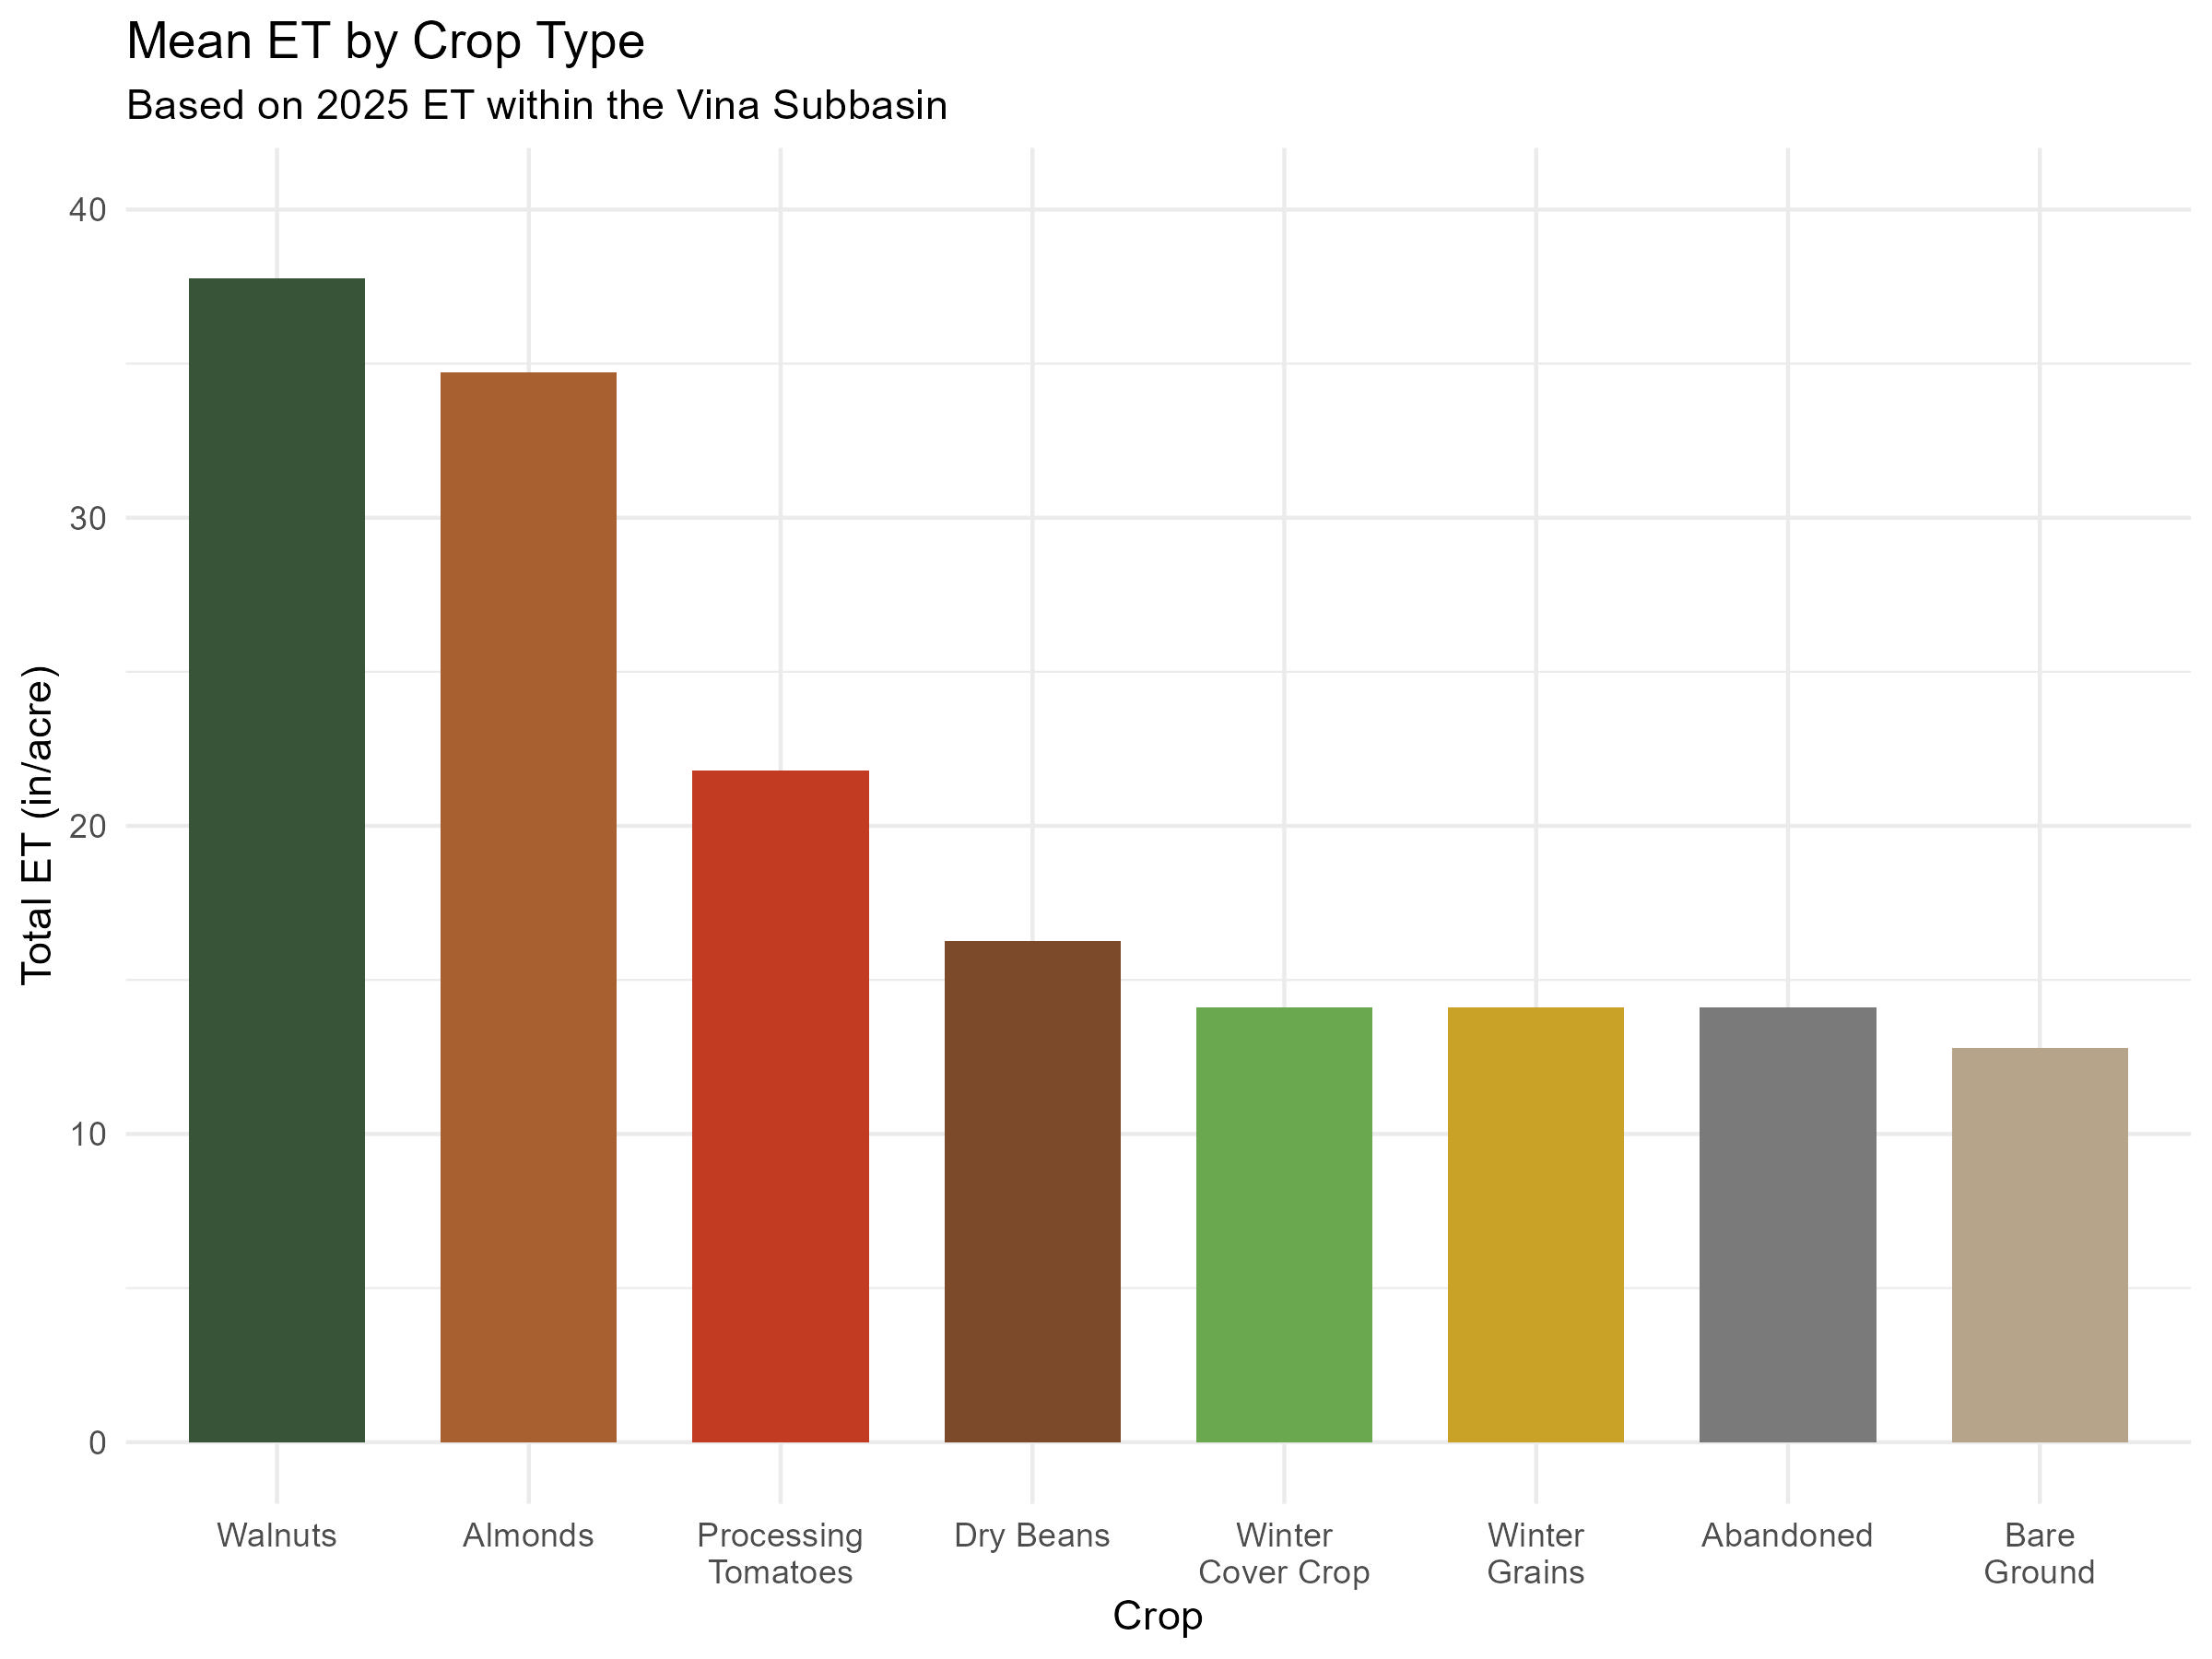
EOR – ET Analysis by Land Use
Different crops have different consumptive use
Growing lower water use crops still saves water
Some crops rely solely on precipitation as their water source
Notes:
Equal growing season lengths were used
If crop wasn’t in the ground for the whole comparable orchard growing season, fallow ET was used for those months

Slide 8
PI – Pilot Study Questions
What are the irrigation scheduling approaches and technologies in use?
What is the potential for demand reduction using precision irrigation?
How can this knowledge be used to guide the GSA in implementing demand reduction programs?

Slide 9
PI – Analysis
Pilot orchards used for analysis
Pruning practices
Irrigation types
Irrigation scheduling technologies
ET
NDVI
Yield
Applied Water
All orchards in Vina Subbasin used to explore potential relationships between
Crop type and age
Irrigation methods
ET
NDVI
Analysis focused on the pilot orchards.
Notes:
Don’t have time to show results of all analyses

Slide 10
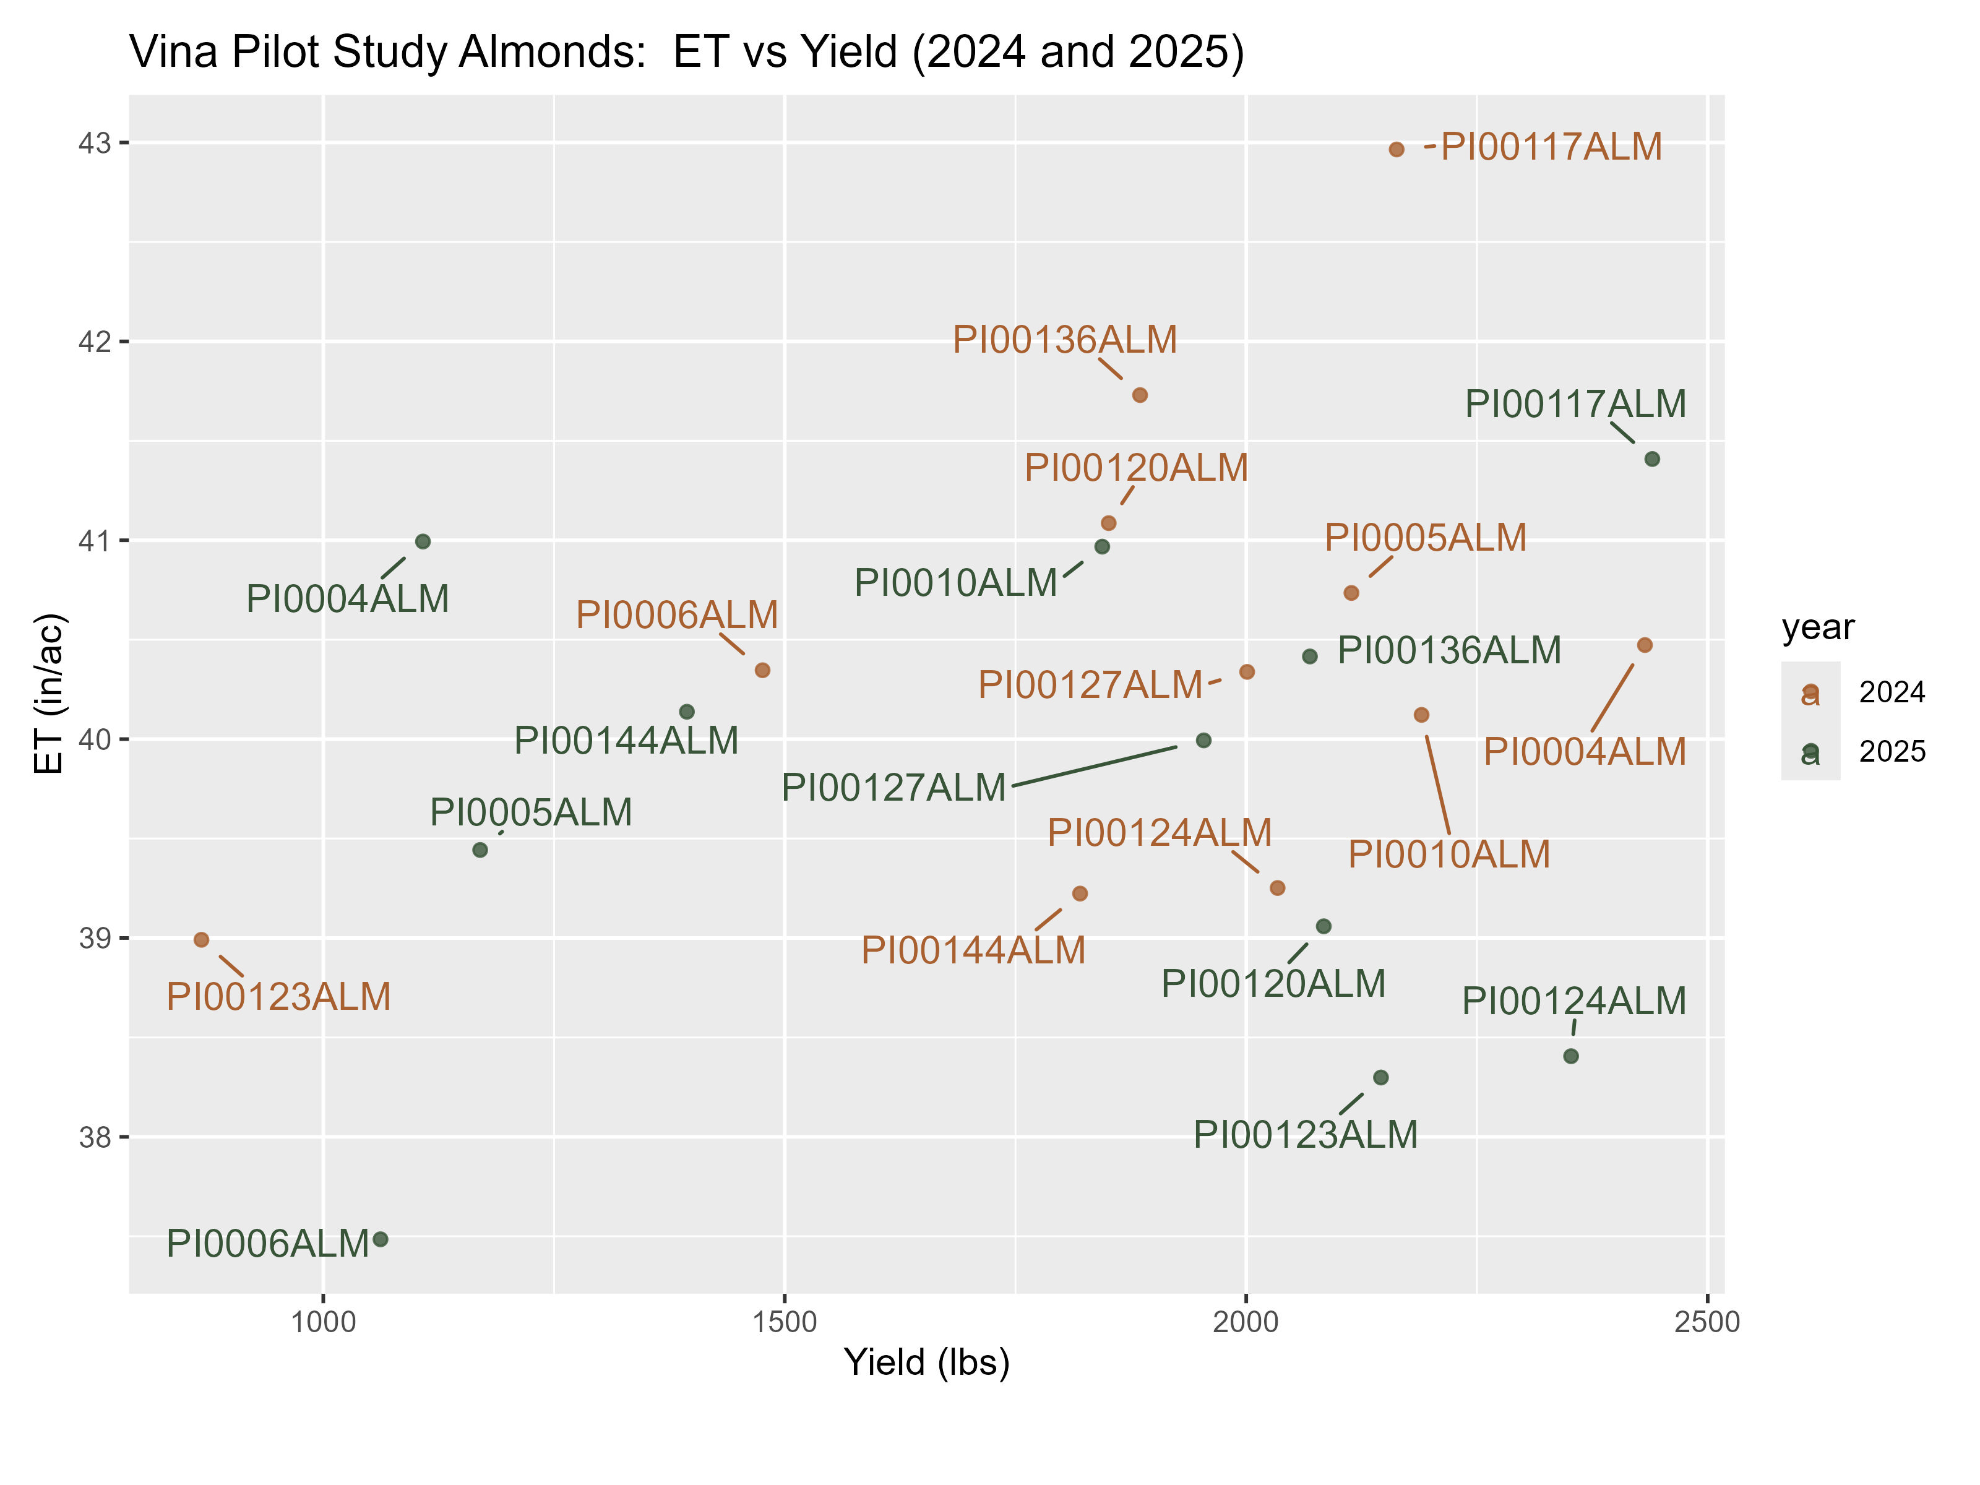
PI – Conclusion 1: Using ET and Yield to Identify Non-beneficial Consumptive Use
Almonds:
No correlation between yield and ET.
Few, if any orchards are purposely deficit irrigated
Yields are affected by many factors
P-value: 0.223, R²: 0.0268
Notes:
ET = January to March
2024 ET = SIMS data corrected to/calibrated by Land IQ ET
Some orchards exhibited relatively low yields but had relatively high ET. This combination is indicative of non-beneficial ET that occurs from weeds, excess canopy growth, weeds on orchard floors and/or ponded irrigation water. However, some of these same orchards had relatively high yield and low ET in the second year. Multiple years of data are needed to determine if orchards have consistent high or low productivity.

Slide 11
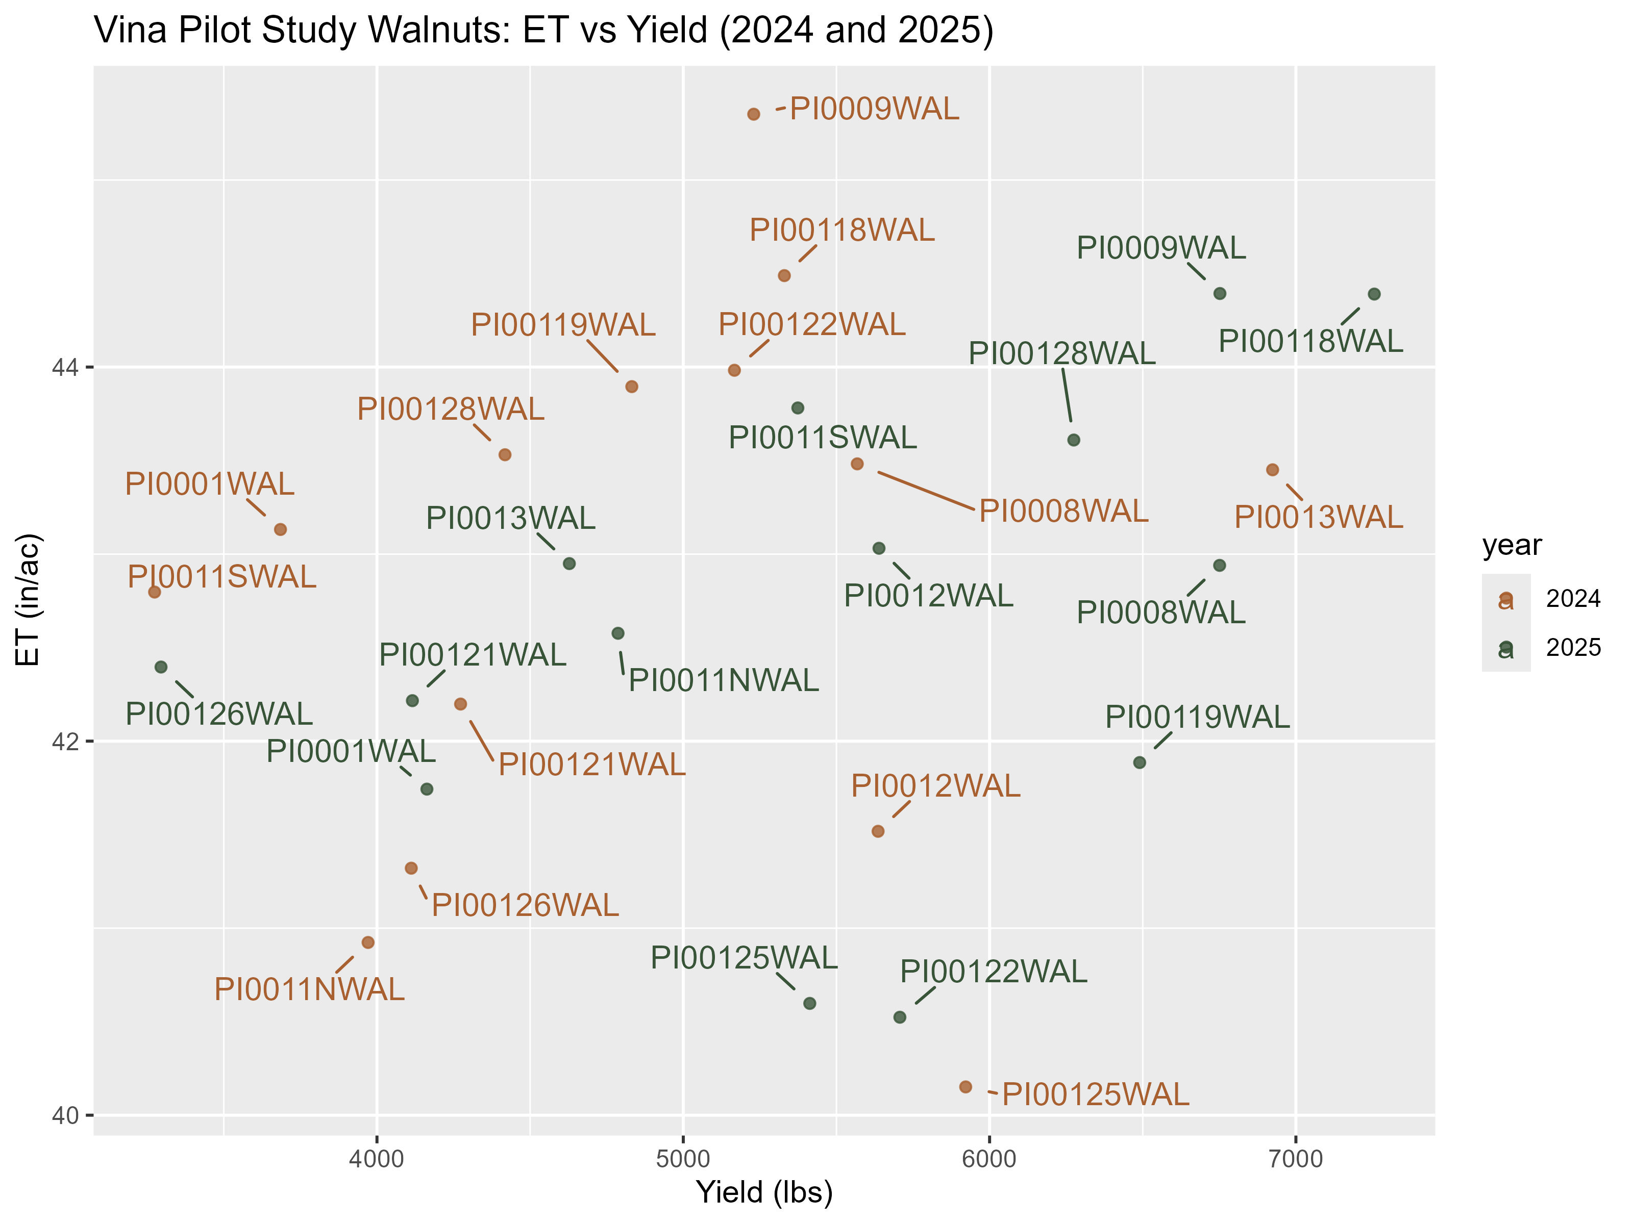
PI – ET and Yield in Walnuts
Walnuts:
No correlation between yield and ET.
Few, if any orchards are purposely deficit irrigated
Yields are affected by many factors
P-value: 0.247, R²: 0.0146
Notes:
Orchard yield depends on myriad factors that change yearly and include but are not limited to water. Factors such as disease can limit yield even when irrigation and consumtive use is optimized. Pruning practices can also impact yield for short periods but may ultimately benefit yield in subsequent years.

Slide 12
PI – Conclusion 2: Potential for Demand Reduction using PI on Mid-Large Farms
There is likely little opportunity to reduce crop evapotranspiration (ETc) with irrigation scheduling in medium to large size almond and walnut orchards.
PI Technical Bulletins and Case Studies
Methods for Determining When and How Much to Irrigate – growers are optimizing irrigation with technology
Minimizing Midday Irrigation – water savings potential comes with “heavy lift” on farms
Notes:
In the PI pilot study, applied water was less than ET in all but two orchards.
The reason growers can irrigate with less water than ETc is because they are maximizing other sources of water that crops can use to meet ETc such as stored soil moisture, in-season rainfall, and possibly at times slow capillary movement of soil moisture from seepage from nearby natural water ways.
Growers in the PI pilot generally had good on-farm irrigation efficiency and minimized groundwater pumping and used the best technology available and were generally proactive in their irrigation management.
This behavior is likely representative of medium to large size orchards, which were represented in the Butte County Ag Survey as adopting irrigation scheduling technology more than small farms.
Case Studies
Methods for Determining When and How Much to Irrigate
ET Sources for Irrigation Management – in process
Precipitation Data Comparison – in process
Technical Bulletins
Minimizing Midday Irrigation
Integrating Field Technologies into Irrigation Decision Support
Field Level Measurements of Applied Water

Slide 13
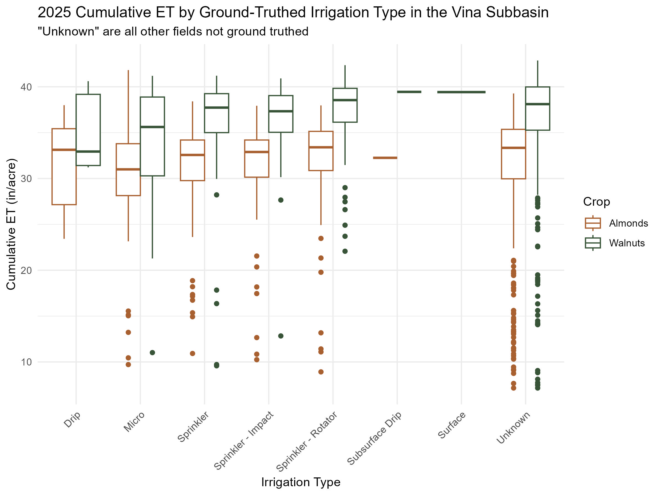
PI – Conclusion 3: Irrigation Systems
Irrigation system management was more important than irrigation type in maximizing water use and water productivity (water use as a function of yield).
Notes:
Used irrigation ground truth data to compare types with ET of almond and walnut on whole subbasin.
NA = orchards that are not ground truthed for irrigation type, though we know the crop type – includes all the irrigation types

Slide 14
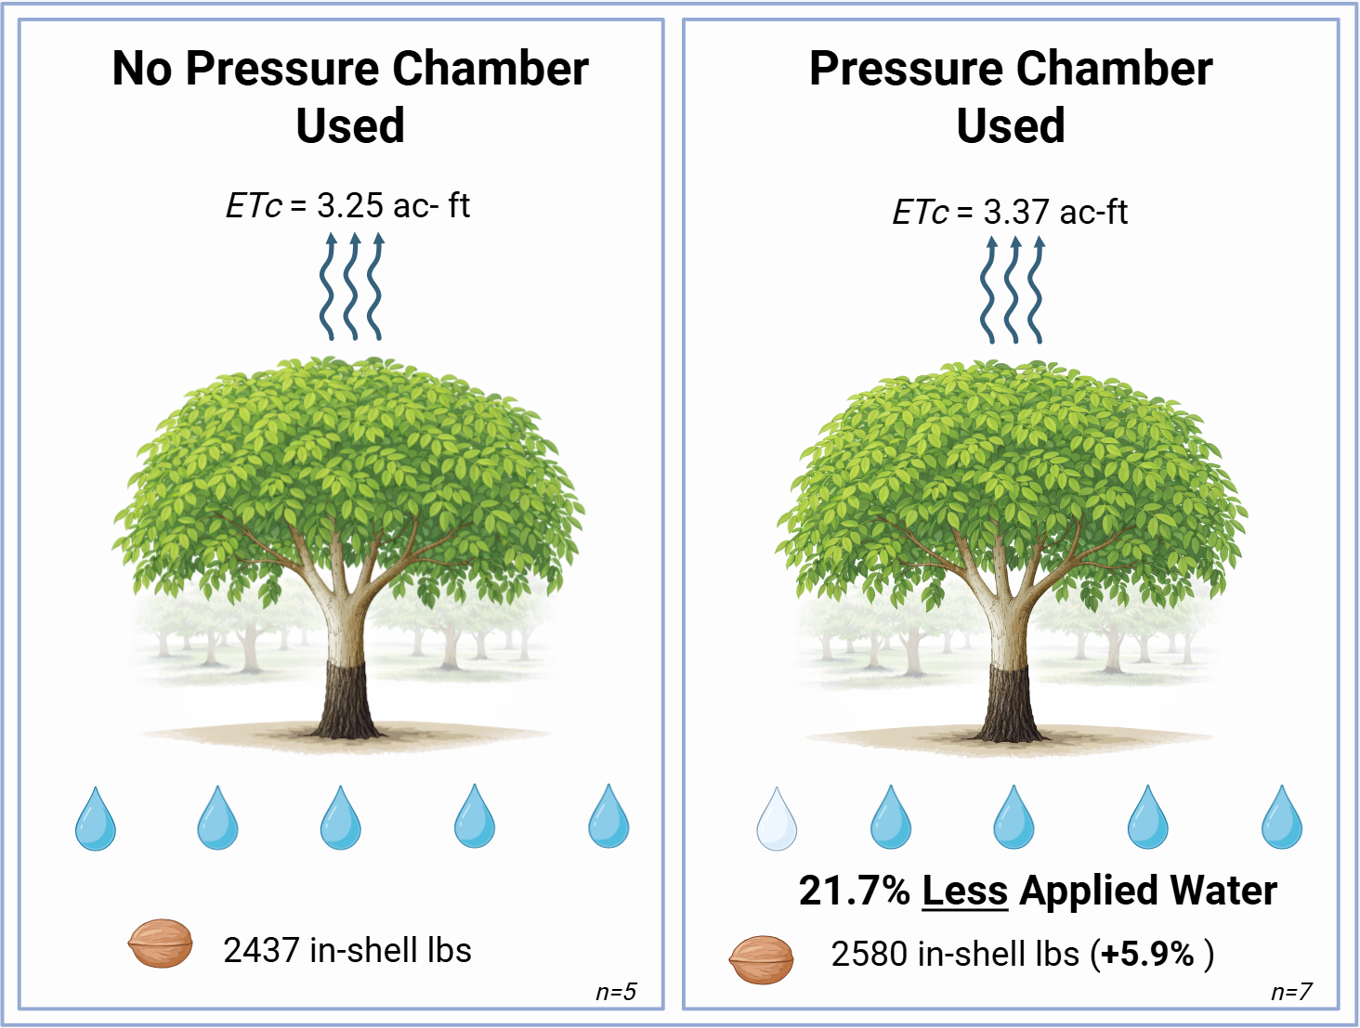
PI – Conclusion 4: Pressure Chambers
Walnuts appeared to respond to less irrigation while improving production, though this trend was not the same in almonds.
Notes:
Growers using pressure chambers irrigated less, and the lower applied water in some walnut orchards is likely attributable to starting irrigation later in the spring.
The use of pressure chambers likely has a positive effect on water efficiency because they provide growers with data that justifies starting irrigation later in the season instead of growers having no data and erring on the early side of irrigation to ensure trees are not stressed.

Slide 15
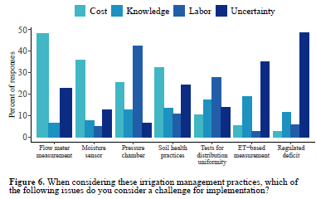
PI – Conclusion 5: Potential for Demand Reduction using PI on Small Farms
Butte County Survey (2021) - these technologies are not used as much on small farms.
70% of farms are <100 ac and account for 30% of acreage.
Highest barrier to pressure chamber adoption overall is labor.
Notes:
The PI pilot study focused on medium to large sized farms using technologies to schedule irrigation and measure applied water.
The Butte County Farmer Survey (2021) indicated that these technologies were not adopted as much on small farms.
A key component for the smaller grower would be working with a consultant, which would provide information and access to technology advances that are normally only available for larger operations.
The potential to reduce groundwater demand through improving irrigation and farm practices would need to be investigated by the GSA to determine what that potential is and what the associated effort would be needed to realize it.
639 individual landowners that owned an almond or walnut orchard in the subbasin from 2019 to 2024. Of these 639 owners, 6 had more than 500 acres, 91 had 100-500 acres, 95 had 50-100 acres, and 447 had 1-50 acres.
Average orchard ET did not differ when compared between grouped small farms (5-50 ac) and grouped large farms.

Slide 16
PI – Conclusion 6: Minimizing Midday Irrigation
Values from literature that need to be locally validated
Potential for saving 7.6 inches of ET
630 ac-ft of groundwater pumping per 1,000 irrigated acres lost to evaporation
Target orchards with lower weekly water requirements of mature orchards, more barren soils than vegetation in middles
Micro or mini-sprinkler irrigation
20 to 60 percent canopy cover (3 to 8 years old)

Slide 17
PI – Summary of Conclusions
The PI pilot study demonstrated how ET and yield can be used to determine orchards with non-beneficial ET.
There is little evidence from the PI pilot study that there is substantial opportunity to reduce ET with precision irrigation in medium to large almond and walnut farms.
Irrigation system management was more important than irrigation type in maximizing water use and water productivity (water use as a function of yield).

Slide 18
PI – Summary of Conclusions
Walnuts appeared to respond to less irrigation while improving production, though this trend was not the same in almonds.
There may be more potential for improved water management, including both irrigation efficiency and minimizing non-beneficial ET, on small farms. Farms <100 acres represent 30% of acreage.
There may be potential to reduce the evaporation portion of ET by using more nighttime irrigation and less daytime irrigation.

Slide 19
Recommendations
EOR
Apply economic and financial analysis to standardize and compare EOR, PI and other PMA costs per AF
Implement first with small-scale or pilot study
PI
If the Vina GSA wishes to pursue identification of non-beneficial ET in almond and walnut orchards, it would need multiple years of yield and ET data from orchards to determine how non-beneficial ET occurs.
To maximize demand reduction from efforts, the Vina GSA should investigate acreage and technology adoption by farm size, then determine potential demand reduction.
The Vina GSA should focus its efforts related to specific irrigation management practices on the use of pressure chambers as components of an advanced technology approach to irrigation scheduling, either through outreach and education and/or incentivizing technology, particularly in walnut production.
If the Vina GSA wishes to pursue a move away from midday irrigation, education and outreach would be needed on the associated financial savings, and potentially assistance in implementing automation.

Slide 20
EOR Program Concepts
Incentivize extended replanting period
Cover crop or other activities during idle period
Evaluated idle period 1 – 3 years
Incentive payment compensates for the present value of forgone income during the idle period
Land costs, taxes, overhead; delayed replanting costs; delayed income
Range reflects different costs and prices
Water savings
Measured as AW or ET
Measured as annual amount or amount over life of the orchard

Slide 21
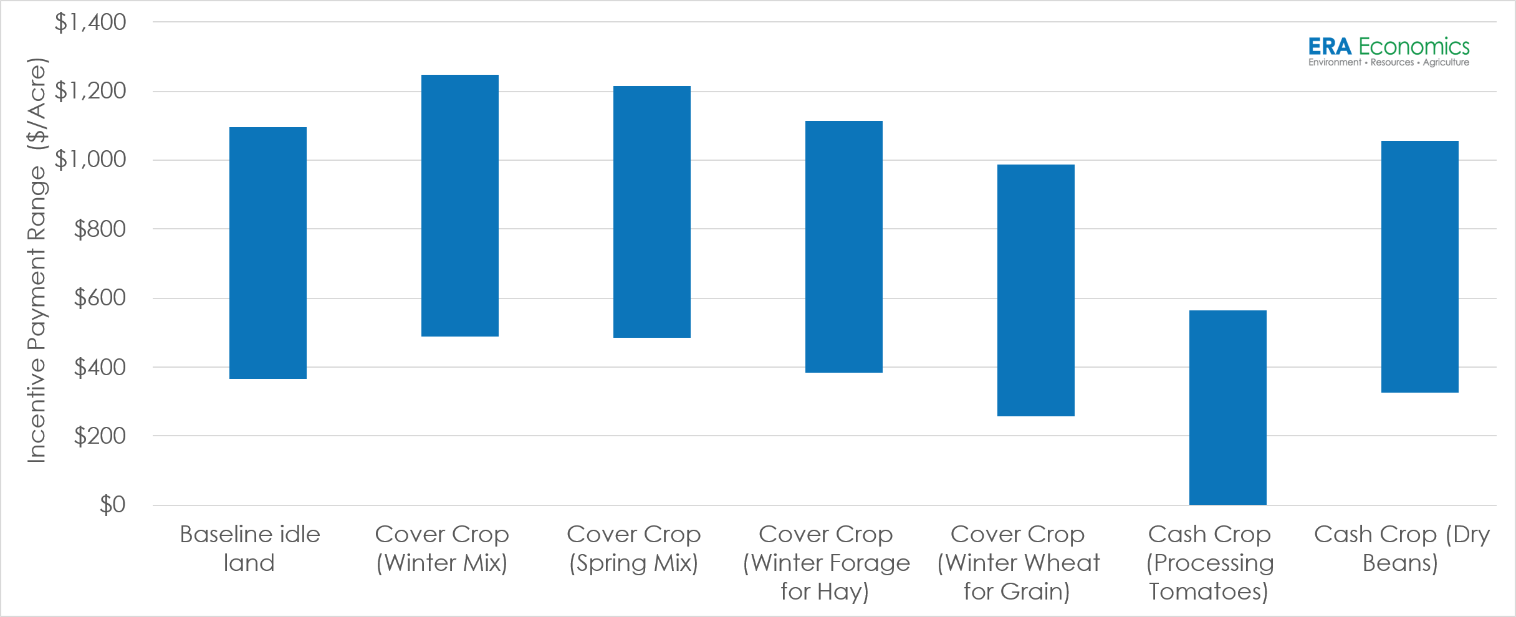
EOR Incentive Payment Range (1 Year Idle)

Slide 22
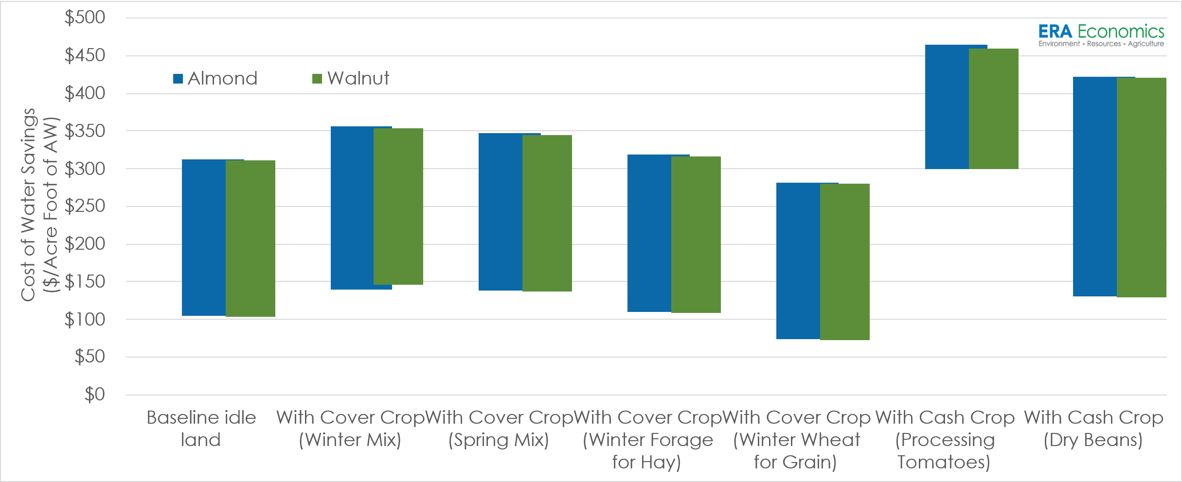
Annualized Cost of EOR AW Savings (1 Year Idle)

Slide 23
Program Development
Program Element | Description
Administration | Staff, data, technical expertise to administer the program
Funding Strategy | Financial and economic analysis for the resources required to run the program
Program Rules / Guidelines | Clear program guidelines – eligibility, duration, scale, application periods, selection process, enrollment process, etc.
Incentive Payments | Amounts and process for establishing incentive payments – fixed price, bids, reverse auction, other approaches; tied to funding strategy and revisited annually
Contracts / Agreements | Agreement between participant and program administrator that defines responsibilities of the parties
Monitoring and Enforcement | Process for measuring water savings and ensuring compliance with program guidelines
PMA Integration and Adaptive Management | Process for review and integration with other PMAs, including ongoing financial analysis to evaluate least-cost implementation strategies; process for revising the program as new information is developed

Slide 24
Recommendations
Apply economic and financial analysis to standardize EOR, PI, and other PMA costs to support evaluation of a cost-effective GSP implementation portfolio
Develop draft EOR program guidelines, bidding/selection process, and monitoring process and test in a limited-scale Pilot Program
Use Pilot Program and economic/financial analysis to integrate EOR with PI and other PMAs for GSP implementation

